Slide 1
SUPPLY CHAIN MANAGEMENT
Dashboard Insights and Key Takeaways

Slide 2
Executive Summary
Mission and Vision :
Mission : To optimize and streamline supply chain processes through data-driven insights, leveraging advanced analytical tools like Excel, Power BI, SQL, and Tableau to enhance decision-making, reduce costs, and improve overall efficiency.
Vision : To create a highly efficient, transparent, and resilient supply chain system that utilizes cutting-edge data analytics to anticipate challenges, drive innovation, and support sustainable growth across the organization.
Key Areas of Operation
Inventory Management: Monitor and control stock levels to reduce holding costs.
Supplier Performance: Evaluate and improve supplier relationships and performance.
Cost Analysis: Analyze and reduce overall supply chain costs.

Slide 3
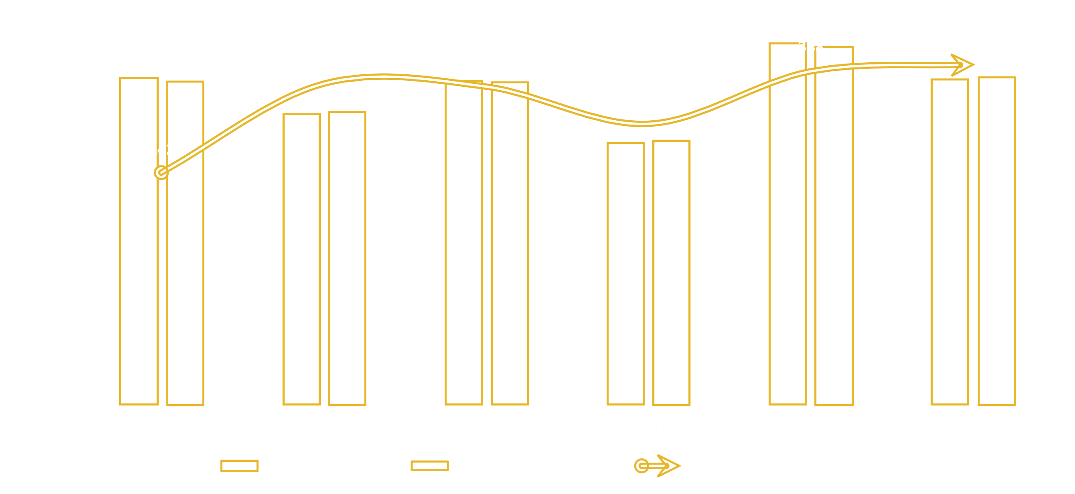
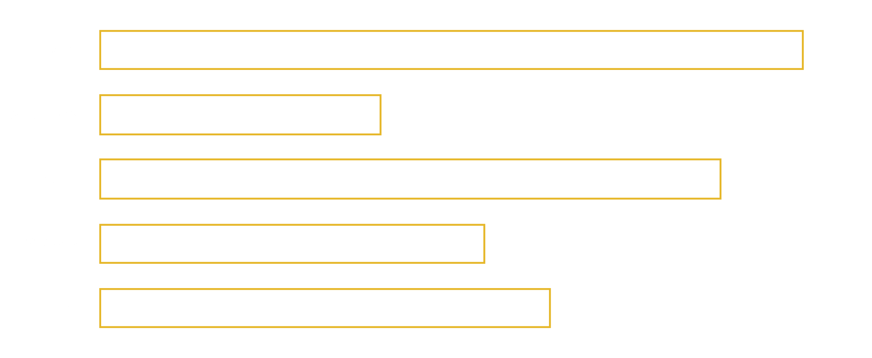
Key Performance Indicators (KPIs)
Stock Detail
Region wise Sale

Slide 4
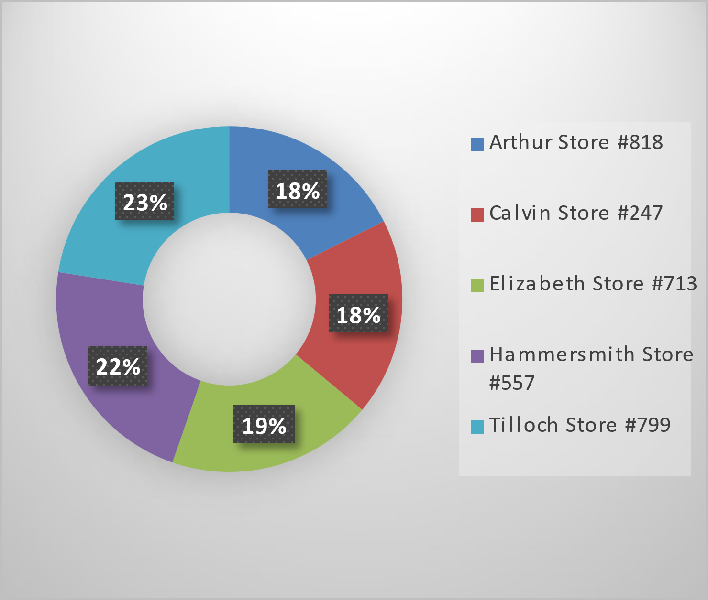
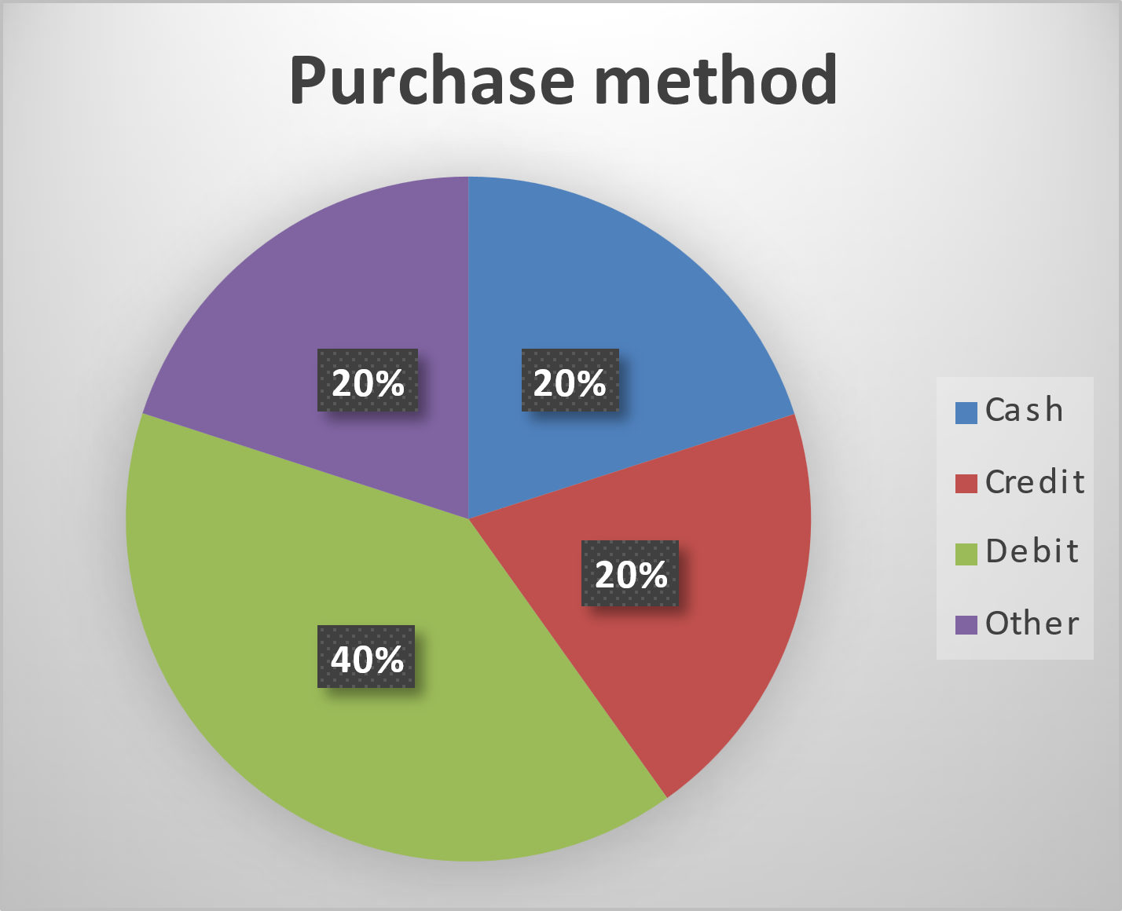
Top 5 Store wise Sales
Purchase Method

Slide 5

Year , Quarter , Month wise Sale

Slide 6
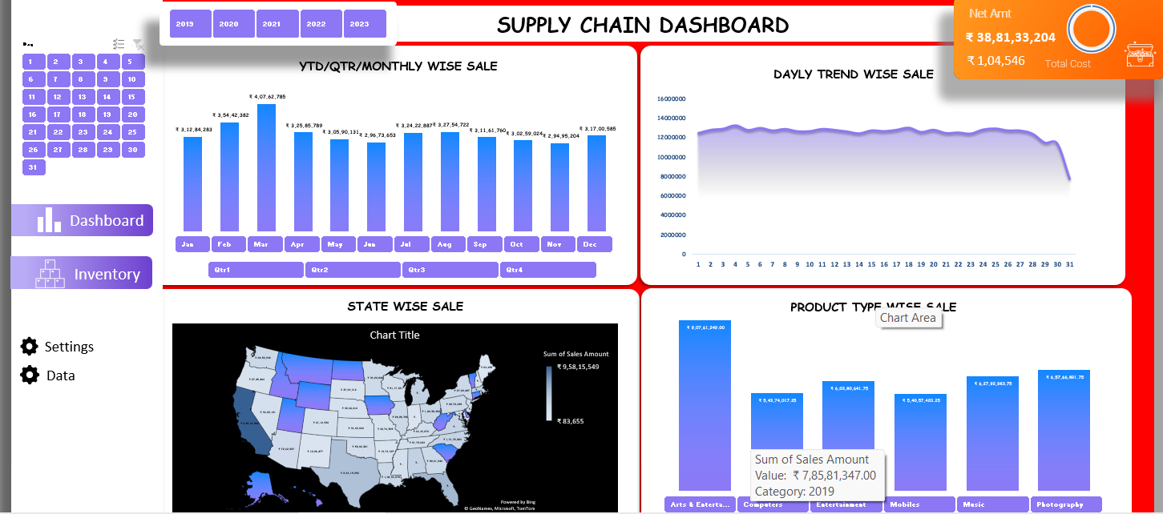
Excel Dashboard

Slide 7
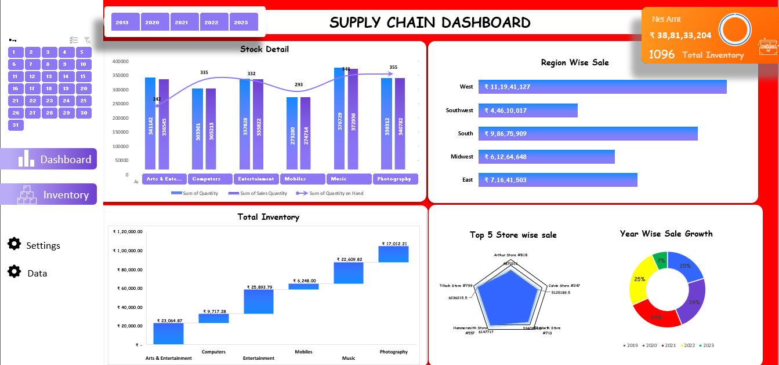
Excel Dashboard (Inventory)

Slide 8
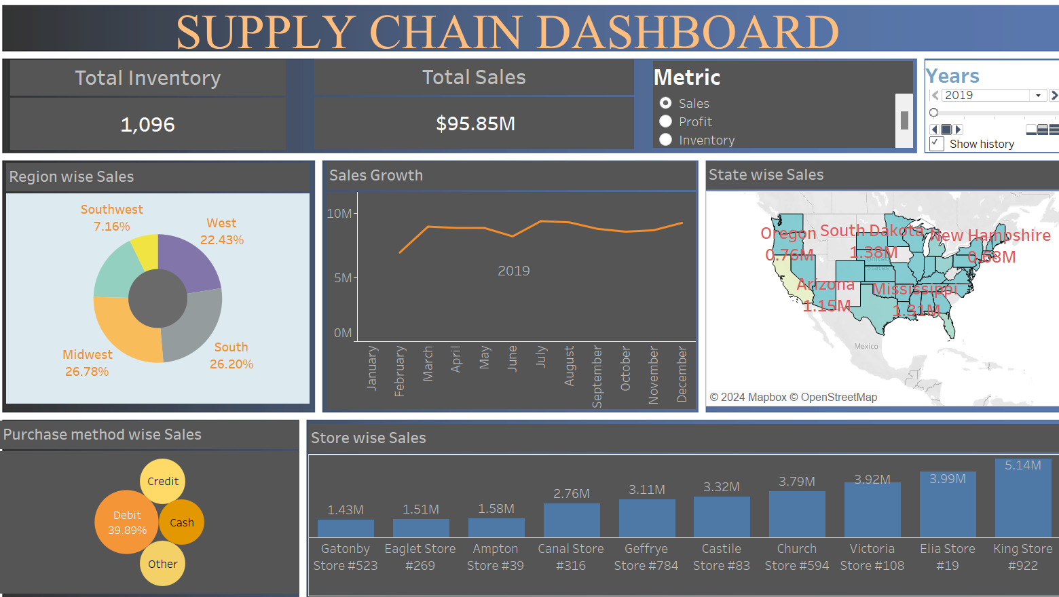
Tableau Dashboard

Slide 9
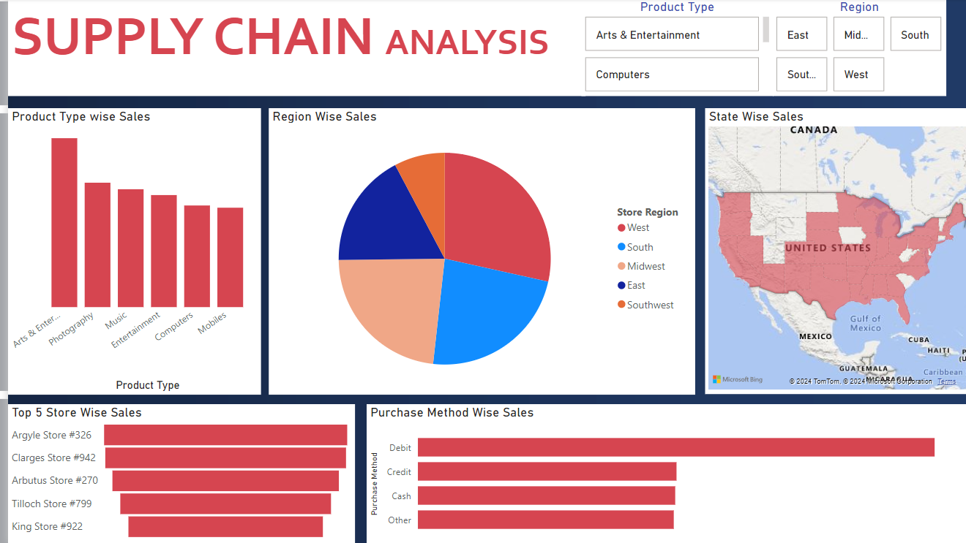
Power BI Dashboard

Slide 10

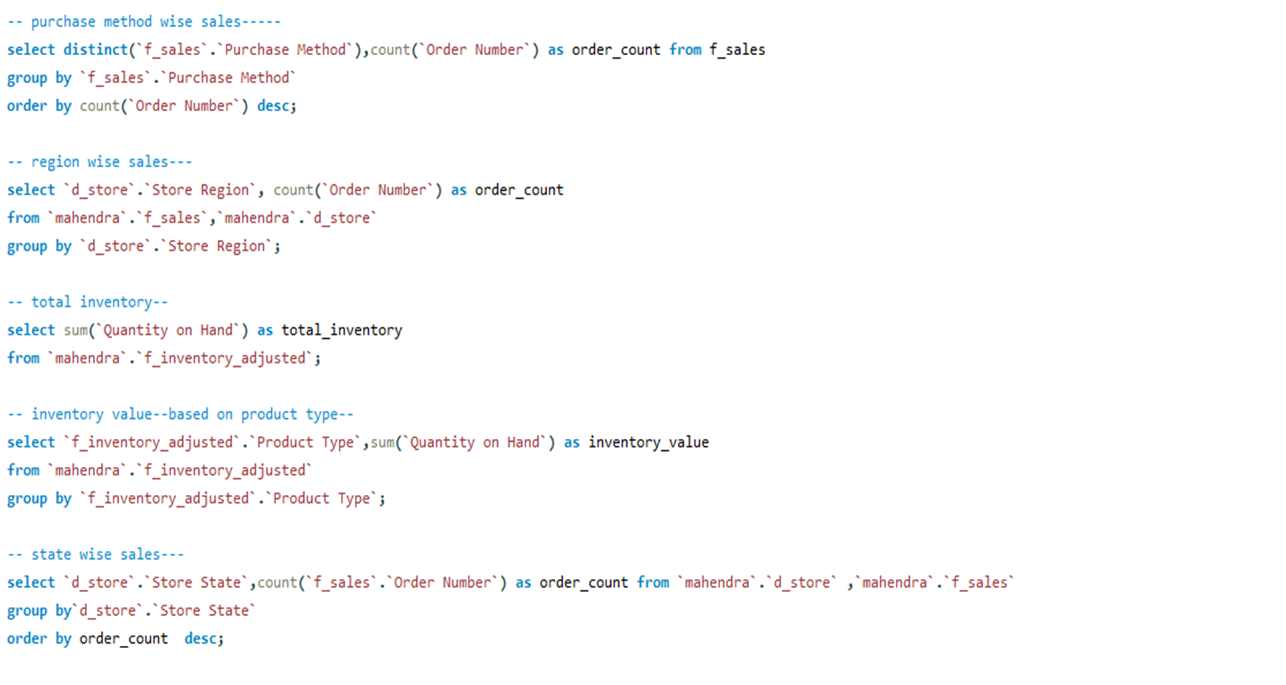

Slide 11
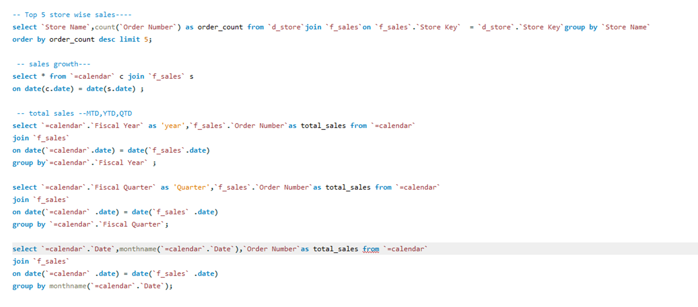
SQL Queries

Slide 12
Key Takeaways
Data-Driven Decision Making: Utilizing data insights to inform strategic and operational decisions.
Efficiency Improvement: Streamlining processes to reduce waste and increase productivity.
Cost Optimization: Identifying cost-saving opportunities across the supply chain.
Enhanced Visibility: Gaining real-time insights into supply chain operations for better oversight.
Risk Mitigation: Proactively identifying and addressing potential risks.
Sustainability: Building a supply chain that supports long-term growth and environmental responsibility.

Slide 13
Key Achievements
Enhanced Demand Forecasting: The project improved demand forecasting accuracy by over 30%, allowing for better alignment of inventory with actual customer needs. This has reduced stockouts and excess inventory, leading to significant cost savings.
Improved Inventory Management: By providing real-time visibility into inventory levels across multiple locations, the project has optimized stock levels, reduced holding costs, and minimized waste. Automated alerts and dashboards now allow for more responsive and efficient inventory management.
Supplier Performance Monitoring: Through the use of data analytics, the project has enabled more precise tracking and evaluation of supplier performance. This has led to more informed decisions in supplier selection, negotiations, and relationship management, ultimately improving the reliability and quality of supplies.

Slide 14
Thank you.

